Slide 1
ET0023 Operating Systems
8. Memory Management

Slide 2
Memory Management Goals
Address space protection
What is address space?
How is it implemented?
Address translation schemes
Segmentation
Paging
Multi-level translation
Inverted Page tables
Notes:
An address space is the set of addresses that a process can use to address memory
Each process has its own address space, independent of those belonging to other processes.
Address space creates a kind of abstract memory for processes to run in.
Memory manager’s job is to efficiently manage memory: keep track of which parts of memory are in use, allocate memory to processes when they need it, and deallocate it when they are done.

Slide 3
Virtualizing Resources
Physical reality:
Different Processes/Threads share the same hardware
Need to multiplex CPU
Need to multiplex use of Memory
Need to multiplex disk and devices
Why worry about memory sharing?
The complete working state of a process and/or kernel is defined by its data in memory (and registers)
Probably don’t want different threads to even have access to each other’s memory (protection)
Notes:
Memory hierarchy
A few MB of very fast, expensive, volatile cache memory
A few GB of medium-speed, medium priced, volatile main memory.
A few TB of slow, cheap, non-volatile disk storage.
Memory Manager in OS manages Memory hierarchy
Manages memory efficiently; keep track of memory in use, allocate memory to processes and deallocate memory.

Slide 4
Single & Multithreaded Processes
code
Data
Files
code
Data
Files
Regs
Stack
Regs
Regs
Regs
Stack
Stack
Stack
Single-threaded process
Multi-threaded process
Threads encapsulate concurrency (active component of a process)
Address space encapsulates protection (keeps a buggy program from crashing other programs)
Notes:
Protection and relocation are two problems that have to be solved to allow multiple applications to be in memory at the same time without their interfering with each other.

Slide 5
Important Aspects of Memory Multiplexing
Isolation
Separate state of processes should not collide in physical memory.
Sharing
Sometimes we would like the ability to overlap when desired.
Virtualization
Create the illusion of more resources than there exist in the underlying physical system

Slide 6
Binding of Code and Data to Memory
Choose addresses for code and data from standpoint of processor
Could we place data1, start, checkit at different addresses?
When ? Compile / Load / Execution time ?
data1: dw 32 … start: ld idx,data1 ld ax, #0 loop: add ax, idx incr idx cmp idx,#maxv bnz loop checkit: … |  | 0x300 00000020 … … 0x900 8C2000C0 0x904 0C000340 0x908 2021FFFF 0x90C 1420FFFF … 0xD00 …

Slide 7
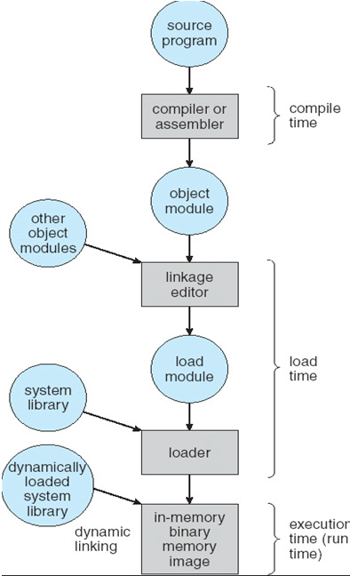
Processing of a program
Preparation of a program for execution involves components at
Compile time (i.e. “gcc”)
Link/Load time (unix “ld” does link)
Execution time (e.g. dynamic libs)
Addresses can be bound to final values anywhere in this path
Depends on hardware support
Also depends on operating system
Dynamic Libraries
Linking postponed until execution
Small piece of code, stub, used to locate the appropriate memory-resident library routine
Stub replaces itself with the address of the routine, and executes routine

Slide 8
Definitions
The concept of a logical address space that is bound to a separate physical address space is central to proper memory management.
Logical address
generated by the CPU; also referred to as virtual address
Physical address
address seen by the memory unit
Logical and physical addresses
are the same in compile-time and load-time address binding schemes
differ in execution-time address-binding scheme
Notes:
A memory management unit (MMU), sometimes called paged memory management unit (PMMU), is a computer hardware component responsible for handling accesses to memory requested by the CPU. Its functions include translation of virtual addresses to physical addresses (i.e., virtual memory management), memory protection, cache control, bus arbitration and in simpler computer architectures (especially 8-bit systems) bank switching.
The prime objectives of the MMU is to efficiently allocate memory to processes, utilizing as much of the memory available and as little fragmentation as possible.

Slide 9
Definitions
Relocatable | Program image can reside anywhere in memory
Binding | Programs need real memory in which to reside. (When is the location of that real memory determined? ) This is called mapping logical to physical addresses. This binding can be done at compile/link time. Converts symbolic to relocatable. Data used within compiled source is offset within object module
Compiler | Generates the code and addresses. If it’s known where the program will reside, then absolute code is generated, otherwise compiler produces relocatable code
Load | Binds relocatable to physical. Can find best physical location
Execution | The code can be moved around during execution. Means flexible virtual mapping.

Slide 10
Definitions
Dynamic loading | Routine is not loaded until it is called Better memory-space utilization; unused routine is never loaded. Useful when large amounts of code are needed to handle infrequently occurring cases. No special support from the OS is required - implemented through program design.
Dynamic linking | Linking postponed until execution time. Small piece of code, stub, used to locate the appropriate memory resident library routine. Stub replaces itself with the address of the routine, and executes the routine. Operating system needed to check if routine is in processes’ memory address. Dynamic linking is particularly useful for libraries.
Memory management | Performs the above operations, usually with the help of hardware

Slide 11
Uni-programming
No translation or partitioning
Application always runs at same place in physical memory since only one application at a time.
Application can access any physical address.
Application given illusion of dedicated machine by giving it reality of a dedicated machine
FFFFFF
Application
Operating System
000000
Can multi-threading work?

Slide 12
Multi-programming (1st try)
No Translation or Protection
Must somehow prevent address overlap between threads.
Everything adjusted to memory location of program
Translation done by a linker-loader
With this solution, no protection
Bugs in any program can cause other programs to crash or even the OS
FFFFFF
Application 2
Application 1
Operating System
000000
Can multi-threading work?
Notes:
Two problems have to be solved to allow multiple applications to b in memory at the same time without their interfering with each other:
Protection and relocation.

Slide 13
Multiprogramming with Protection
How to protect programs from each other without translation?
Use two special registers base and limit to prevent user from straying outside designated area
If user tries to access an illegal address, cause an error
During switch, kernel loads new base/limit from TCB
User not allowed to change base/limit registers
FFFFFF
limit
Application 2
base
Application 1
Operating System
000000
Notes:
Each CPU is equip with tow special hardware registers, called the base and limit registers.
When a process is run, the base register is loaded with the physical address where its program begins in memory and the limit register is loaded with the length of the program.

Slide 14
Multiprogramming with Protection
Problem: Run multiple applications in such a way that they are protected from one another
Goals:
Isolate processes and kernel from one another
Allow flexible translation that:
Doesn’t lead to fragmentation
Allows easy sharing between processes
Allows only part of process to be resident in physical memory
Hardware Mechanisms:
General Address Translation
Flexible: Can fit physical chunks of memory into arbitrary places in users address space
Not limited to small number of segments
Use fixed-sized segments (called “pages”)
Dual Mode Operation
Protection base involving kernel/user distinction

Slide 15
Background: Memory
Program must be brought (from disk) into memory and placed within a process for it to be run
CPU can only access Main memory and registers directly
Register access in one CPU clock (or less)
Main memory can take many cycles
Cache sits between main memory and CPU registers
Protection of memory required to ensure correct operation

Slide 16
Background: Memory
Hardware device that maps virtual to physical address.
In the Memory Management Unit (MMU), the value in the relocation register is added to every address generated by a user process at the time it is sent to memory.
The user program deals with logical addresses; it never sees the real physical addresses

Slide 17
Dynamic relocation
Dynamic relocation using a relocation register
Memory
Relocation register
20000
CPU
Logical memory
Address
453
Physical memory
Address
20453
+
Memory Management Unit
Notes:
Each time a process references memory, the CPU hardware automatically adds the base value to the address generated by the process before sending the address out on the memory bus.
Simultaneously, it checks if the address offered is equal to or greater than the value in the limit register, in which case a fault is generated and the access is aborted.
Some systems have multiple base registers, allowing program text and data, to be independently relocated.
Disadvantage: need to perform an addition and a comparison on every memory reference.

Slide 18
Dynamic Loading
Routine is not loaded until it is called
Better memory-space utilization; unused routine is never loaded
Useful when large amounts of code are needed to handle infrequently occurring cases (error handling)
No special support from the OS needed

Slide 19
Dynamic Linking
Linking postponed until execution time
Small piece of code, stub, used to locate the appropriate memory-resident library routine
Stub replaces itself with the address of the routine, and executes the routine
OS checks if routine is in processes’ memory address
Also known as shared libraries (e.g. DLLs)

Slide 20
Swapping
A process can be swapped temporarily out of memory to a backing store, and then brought back into memory for continued execution.
Major part of swap time is transfer time; total transfer time is directly proportional to the amount of memory swapped
User Space
Swap out
Process 1
Swap in
Process 2
Operating System
Notes:
On a typical OS system, there are 40-60 processes may be started up when the computer is booted. Keeping all processes in memory all the time requires a huge amount of memory and cannot be done if there is insufficient memory.
The simple strategy, called swapping, consists of bringing in each process in its entirety, running it for a while, then putting it back on the disk.
Idle processes are mostly stored on disk, so they do not take up any memory when they are not running.

Slide 21
Single Partition Allocation
Bare Machine
No protection, no utilities, no overhead
Logical == Physical
User has complete control, OS has none
Partition
Division of physical memory into fixed sized regions.
The number of partitions determines the level of multiprogramming. Partition is given to a process when it's scheduled.
Protection around each partition determined by
bounds ( upper, lower )
base / limit.
These limits are done in hardware
Notes:
For fixed sized partition, the process stack and heap registers may grow above the bounded regions.
Process may need to suspend or other processes may need to be swapped out to make room for the growing process.
If it is expected that most processes will grow as they run, over allocation of memory partition to each process.
If process swapping, only memory actually in use should be swap.

Slide 22
Single Partition Allocation
OS Role / Monitor Program
Primitive Operating System
Usually in low memory where interrupt vectors are placed.
Must check each memory reference against fence (fixed or variable ) in hardware or register. If user generated address < fence, then illegal.
User program starts at fence -> fixed for duration of execution. Then user code has fence address built in. But only works for static-sized monitor.
Isolate user from physical address space using logical address space.

Slide 23
Single Partition Allocation
Limit register
Relocation register
Memory
CPU
<
Yes
Logical
Address
+
Physical
Address
No
Mapping address for single partition

Slide 24
Multiple-partition Allocation
"Hole" block of available memory
Holes of various size are scattered throughout memory
When a process arrives, it is allocated memory from a hole large enough to accommodate it
Operating system maintains information about:
allocated partitions
free partitions (hole)
Process 1
Process 1
Process 5
Process 6
Process 2
Process 3
Process 3
Process 4
Process 4
Process 4
OS
OS
OS
OS
Notes:
Memory compaction is the technique where by all holes are combined into one bit one by moving all the processes downward as far as possible.
This technique requires a lot of CPU time.

Slide 25
Dynamic Storage Allocation Problem
First-fit | Allocate the first hole that is big enough
Best-fit | Allocate the smallest hole that is big enough. Need to search entire list unless ordered by size Produces the smallest left-over hole
Worst-fit | Allocate the largest hole Must also search entire list Produces the largest left-over hole

Slide 26
Fragmentation
External Fragmentation
total memory space exists to satisfy a request, but it is not contiguous
Internal Fragmentation
allocated memory may be slightly larger than requested memory
this size difference is memory internal to a partition, but not being used
Any solutions ?

Slide 27
Paging (An Overview)
Logical address space of a process can be noncontiguous. The process is allocated physical memory whenever the latter is available
Solution:
Divide physical memory into fixed-sized blocks called frames (size is power of 2, between 512 bytes and 8,192 bytes)
Divide logical memory into blocks of same size called pages
Keep track of all free frames.
To run a program of size n pages, need to find n free frames and load program
Set up a page table to translate logical to physical addresses
What sort of fragmentation can be expected?

Slide 28
Address Translation Scheme
Address generated by CPU is divided into:
Page number (p) – used as an index into a page table which contains base address of each page in physical memory
Page offset (d) – combined with base address to define the physical memory address that is sent to the memory Unit
For given logical address space 2^{m} and page size 2^{n}
page number
page offset
m - n
n
Notes:
Example:
Using a 24-bit addressing scheme, logical address space = 2^{m} = 2²⁴ = 16 MB
If page size is 1024 Byte/page, then n = 10 (2¹⁰ = 1024)
Page table size = 2²⁴⁻¹⁰ = 2¹⁴ =16 K pages.

Slide 29
Paging Hardware
An address is determined by:
page number ( index into table ) + offset
mapping into
base address ( from table ) + offset.
f
logical
memory
Physical
memory
CPU
F000….0000
p | d
f | d
.………..
F111….1111
p
f
Physical
memory

Slide 30
Paging Example
32-bit memory with 4-byte frames
Logical memory
Physical memory
0
efgh
mnop
abcd
ijkl
Frame 0
1 | a
2 | b
3 | c
4 | d
4
F1
Page Table
8
5 | e
6 | f
7 | g
8 | h
F2
1 | 4
2 | 1
3 | 6
4 | 2
12
F3
16
9 | i
10 | j
11 | k
12 | l
F4
20
Free frame list
F5
4
1
6
2
7
24
F6
13 | m
14 | n
15 | o
16 | p
28
F7
32
Notes:
16 bytes of logical memory is divided into four 4-byte pages
32 bytes of physical memory is divided into eight 4-byte frames.
Frames 4,1,6,2,7 are currently free.
logical memory page 1 is mapped to physical memory frame 4.
logical memory page 2 is mapped to physical memory frame 1.
logical memory page 3 is mapped to physical memory frame 6.
logical memory page 4 is mapped to physical memory frame 2.

Slide 31
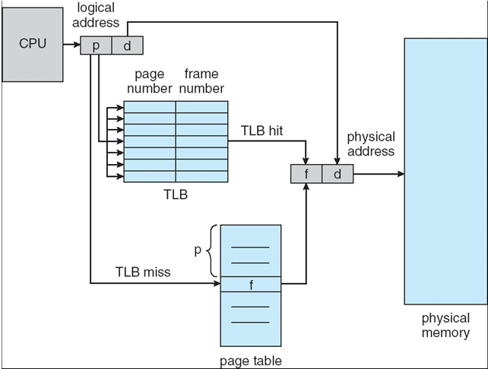
How about "actual" implementations?
A 32-bit machine can address 4GB (4 million pages at 1024 bytes/page)
Solutions?
Could use dedicated registers (too many!)
Could use a register pointing to table in memory (slow)
Cache or Associative memory
Translation Lookaside Buffer (TLB) search is fast and uses only a few registers
Notes:
Using a 32-bit addressing scheme, logical address space = 2^{m} = 2³² = 4 GB
If page size is 1024 Byte/page, then n = 10 (2¹⁰ = 1024)
Page table size = 2³²⁻¹⁰ = 2²² = 4 M pages.

Slide 32
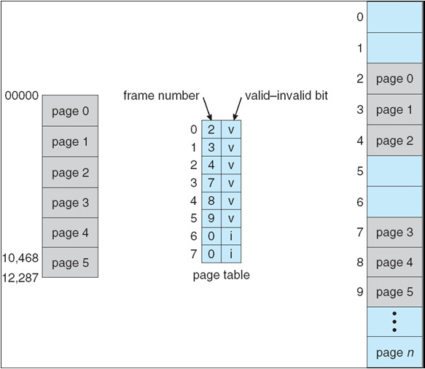
Memory Protection
Implemented by associating protection bit with each frame

Slide 33
Shared Pages
Shared code
One copy of read-only (reentrant) code shared among processes (i.e., text editors, compilers, window systems).
Shared code must appear in same location in the logical address space of all processes
Private code and data
Each process keeps a separate copy of the code and data
The pages for the private code and data can appear anywhere in the logical address space

Slide 34
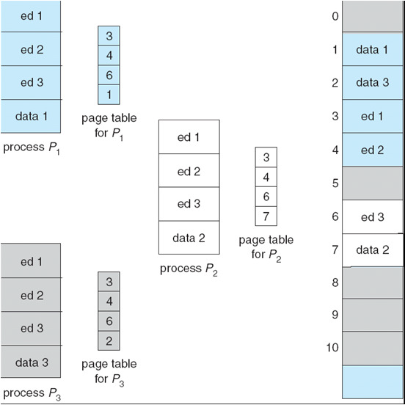
Shared Pages

Slide 35
QUESTIONS

